Slide 1
Transforming higher education training

Slide 3
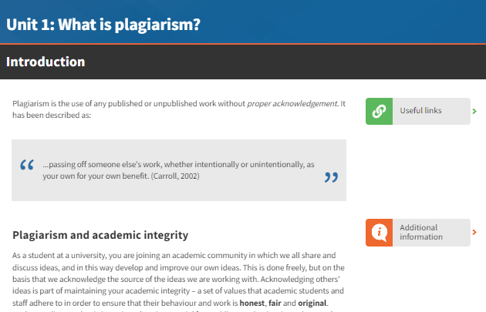
Avoiding Plagiarism
About
Avoiding Plagiarism is designed to ensure your students follow best practices in referencing, paraphrasing and using citations. This online course frames plagiarism through the lens of ownership, attribution and trust, supporting students to understand what academic integrity looks like in an evolving learning environment. Develop student confidence in producing original, ethical academic work through practical skill building and real world scenarios.
The programme is designed for undergraduate and master's students.

Slide 4
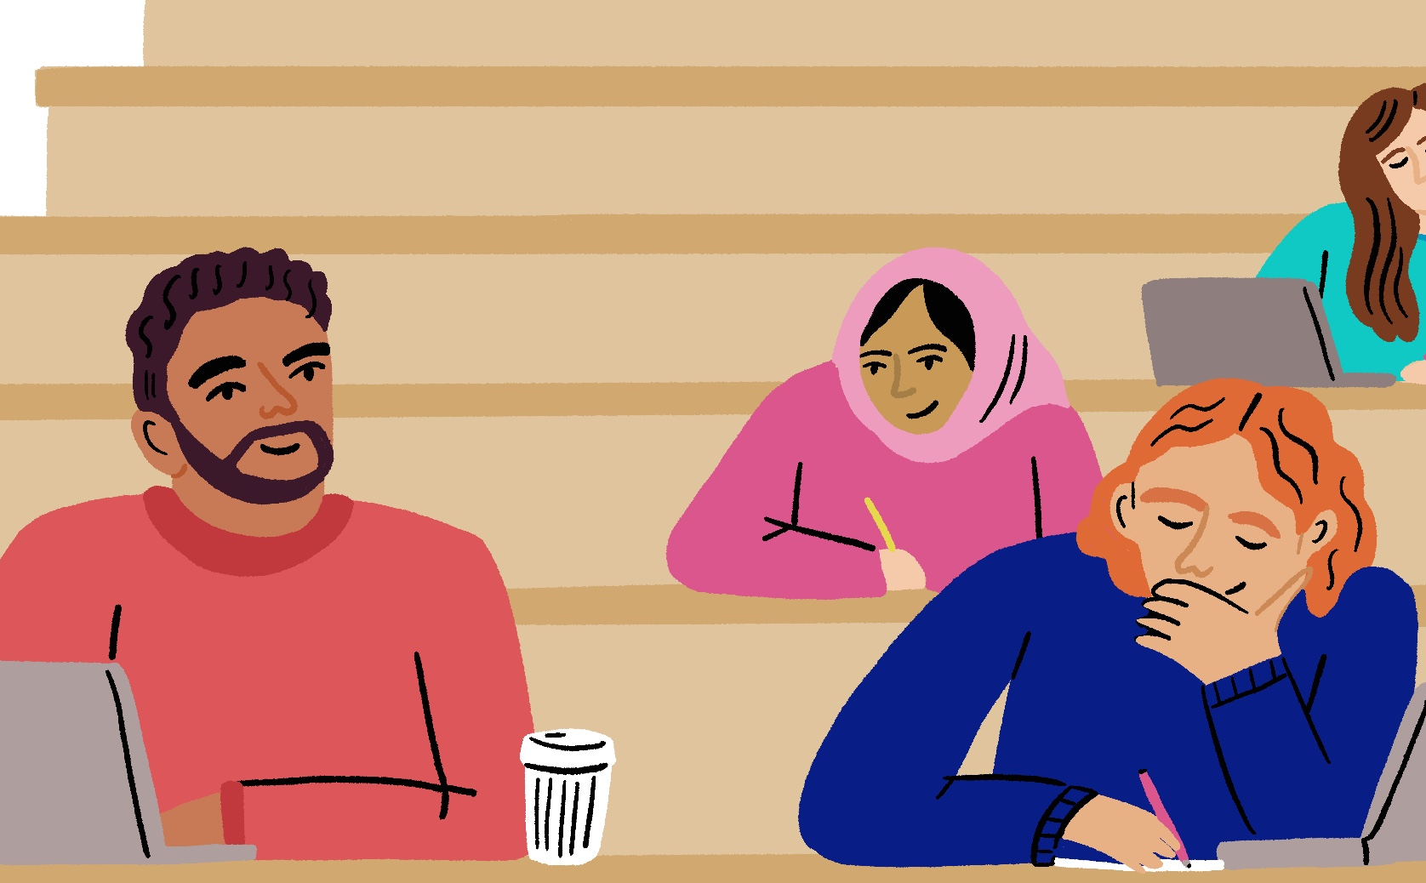

Avoiding Plagiarism
Key Benefits
Support students in building foundational skills in academic writing, referencing, and source integration from the outset of their studies
Equip learners to navigate complex challenges around GenAI, data use, and multimedia content with confidence and integrity
Enhance students’ confidence and independence by developing their academic voice and ethical decision making skills
Future-proof academic integrity education by addressing emerging technologies and evolving definitions of authorship and originality

Slide 5
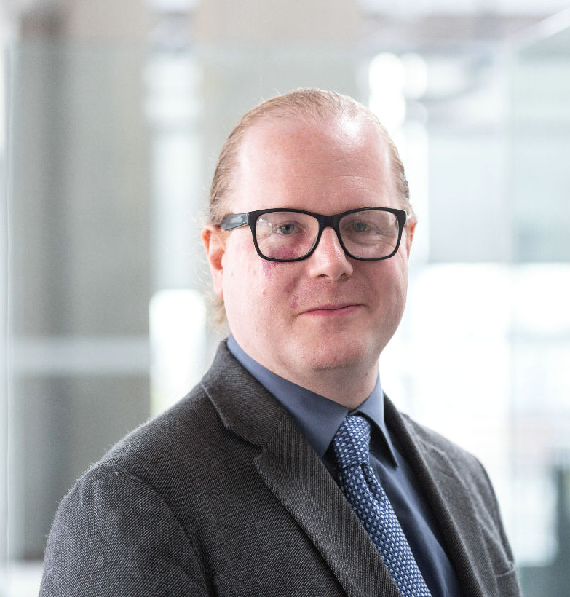
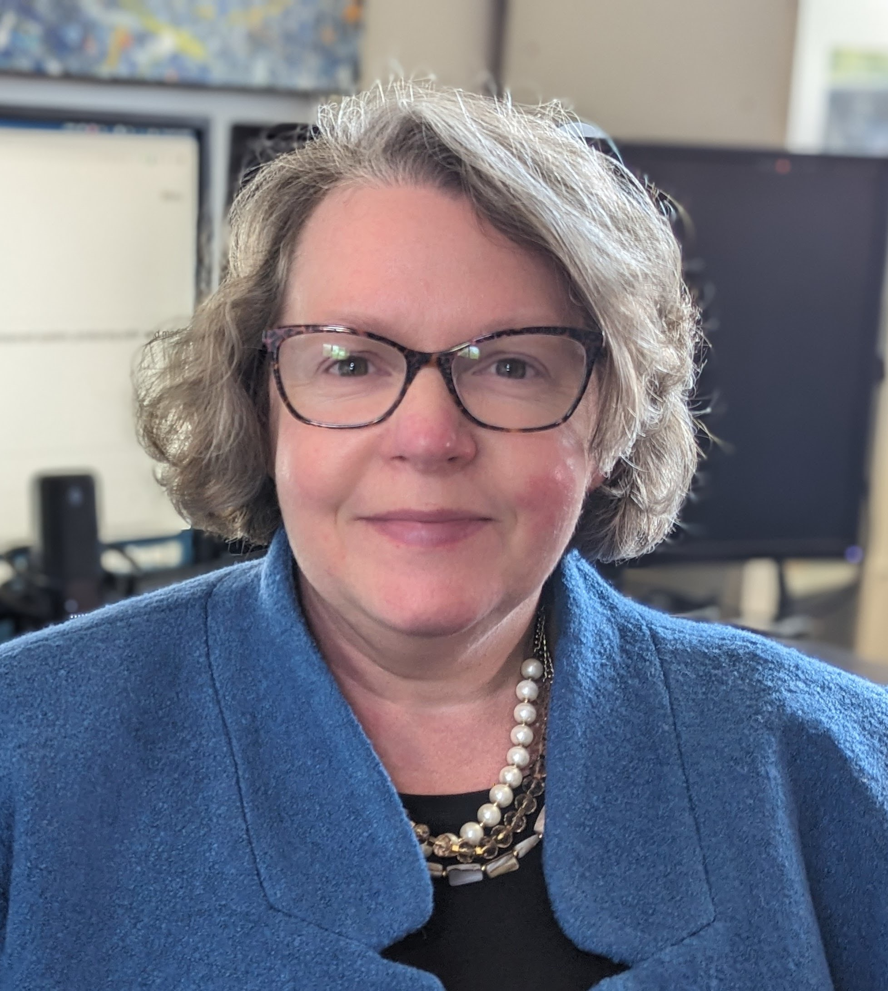

Avoiding Plagiarism
Quality Assurance Agency (QAA)
Dr Thomas Lancaster
Dr Sarah Elaine Eaton
Leading quality agency with extensive experience in regulatory and collaborative quality assurance and enhancement.
Computing professional with 25 years’ experience working in higher education.
Current research interests include educational use of generative AI, academic integrity, and student cheating.
Professor and Research Chair in the Werklund School of Education and Chair, Leadership, Policy, and Governance specialization area. Holds a concurrent appointment as an Honorary Associate Professor, Deakin Learning Futures, Deakin University, Australia.

Slide 6
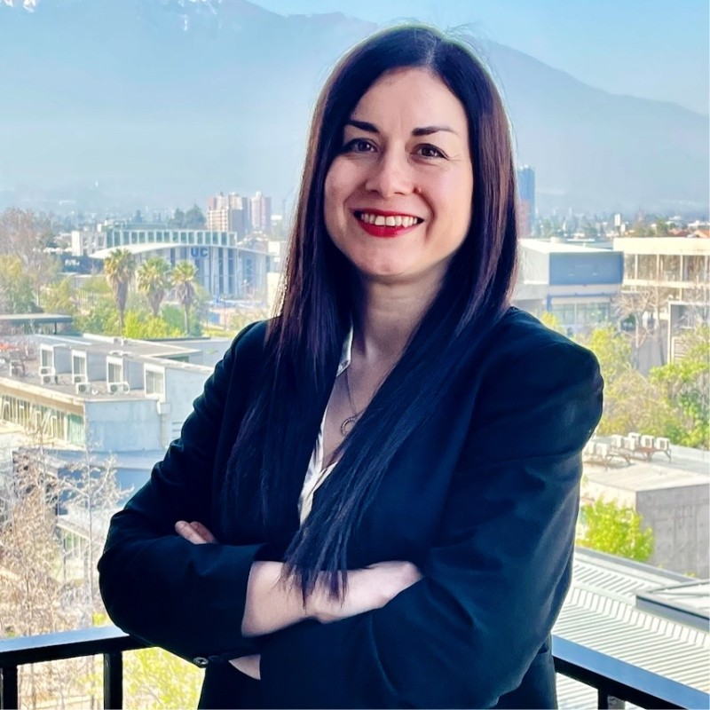
Avoiding Plagiarism
Beatriz Moya Figueroa
Assistant Professor at the Instituto de Éticas Aplicadas, Pontificia Universidad Católica de Chile. She holds a Ph.D. in Educational Research (Leadership, Policy, and Governance) from the University of Calgary.

Slide 7
Avoiding Plagiarism
Plagiarism: from copy and paste to AI
Plagiarism: from copy and paste to AI
Using sources effectively: techniques to prevent plagiarism
Protecting your integrity: strategies for academic success
Closing

Slide 8
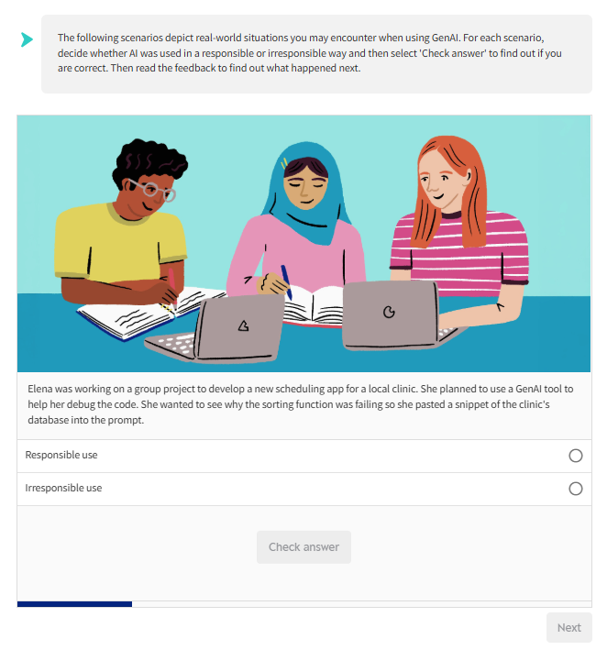
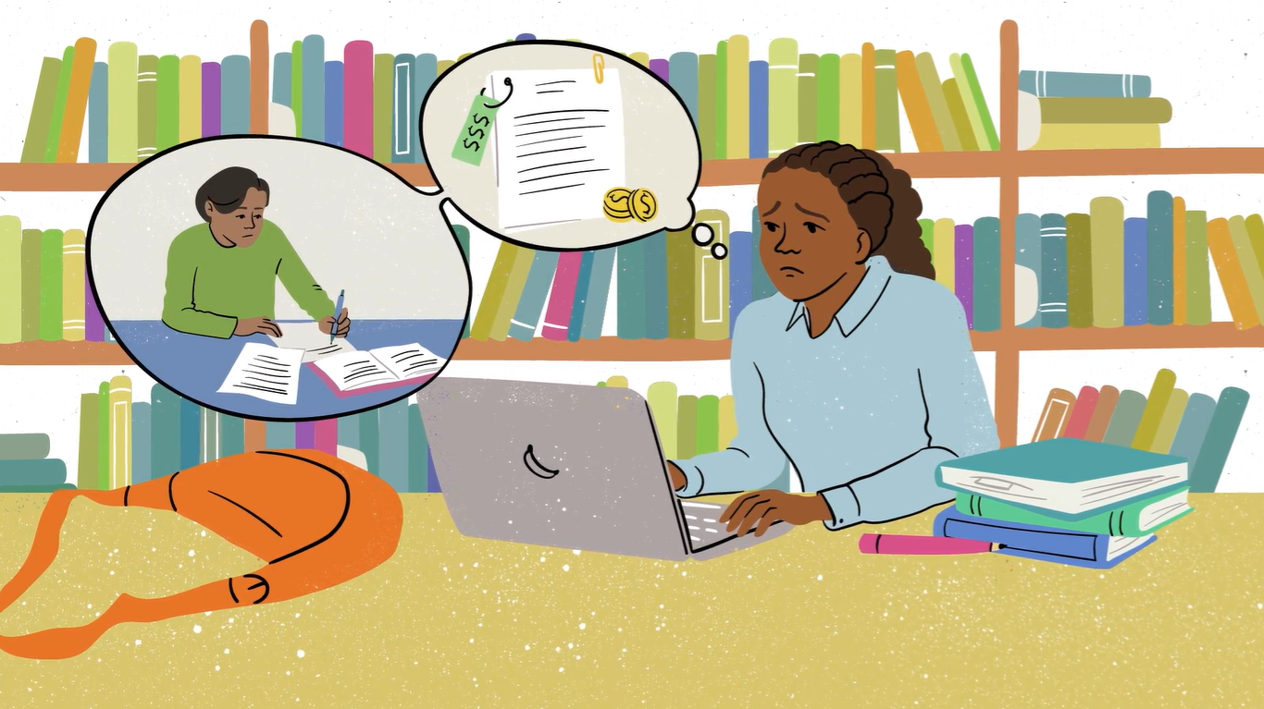
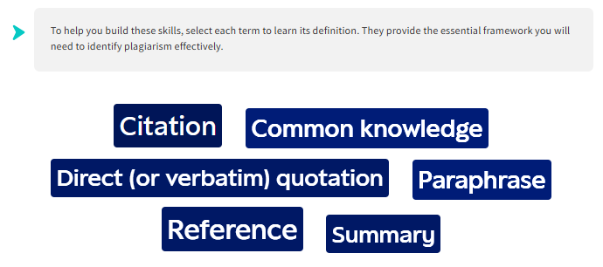
Avoiding Plagiarism

Slide 9
Avoiding Plagiarism
The course was really positive and focused on the personal and professional benefits of maintaining academic integrity. AI was not judged and was presented as a technological advancement to be used.
Engaging, with a variety of different activities and supportive — it offered a lot of help to understand where to utilise strategies and how to spot when it is academic misconduct.
Expert reviewer
Student reviewer

Slide 10
Avoiding Plagiarism
Avoiding Plagiarism can be hosted on your institution’s Virtual Learning Environment, or you can provide access for your students via Epigeum’s dedicated online platform.
Avoiding Plagiarism is accompanied by an Instructor Manual, as well as other resources to support you to implement the programme at your institution.

