Slide 1
Transforming higher education training

Slide 3

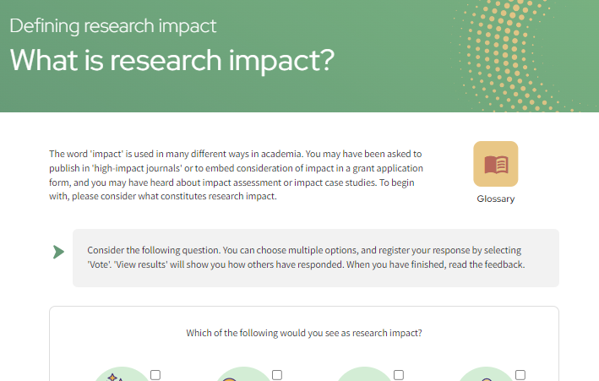
Mastering Mentoring
The Mastering Mentoring program helps institutions strengthen mentoring culture by supporting mentors and mentees to build effective, inclusive and rewarding relationships.
Through dedicated pathways for mentors and mentees, participants develop practical skills in active listening, feedback, reflection and goal setting - building confidence and supporting professional growth across the research community.

Slide 4
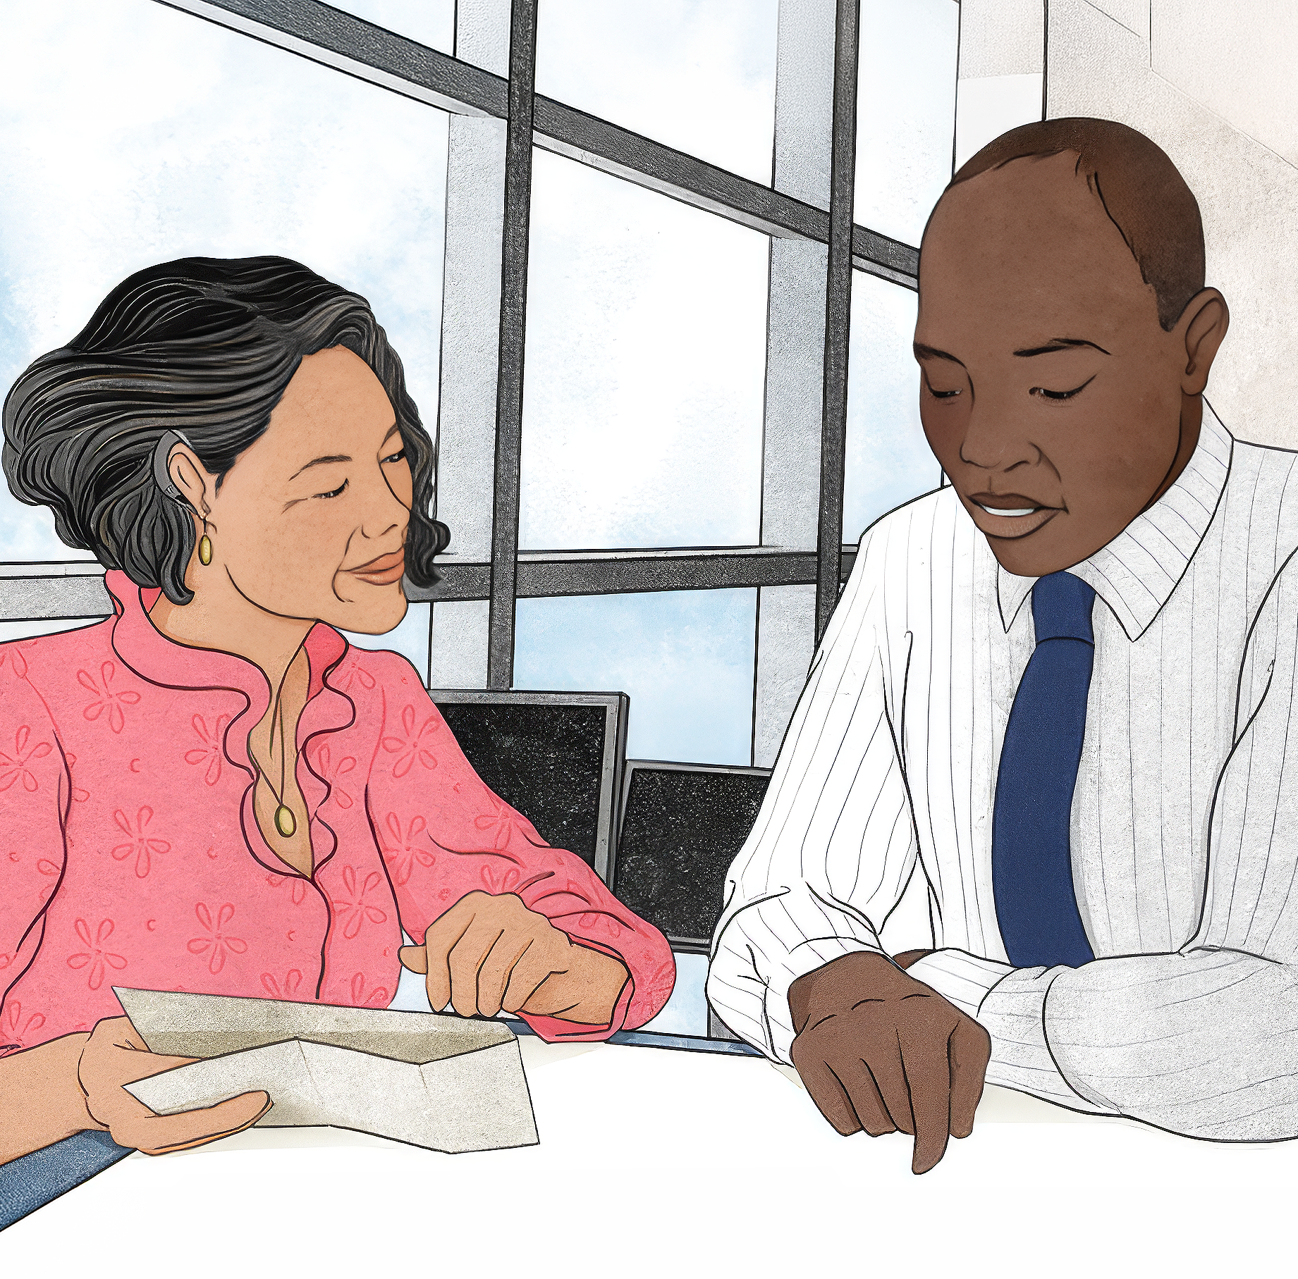
Mastering Mentoring
Key Benefits
Flexible short modules: enabling busy researchers to dip in and out according to their needs
Real life examples and case studies: inspiring stories and video interviews representing a range of researchers from diverse disciplines and different career stages
Downloadable conversation guides and reflective activities: establish effective meeting dynamics
Dedicated content pathways for both mentor and mentees

Slide 5
Mastering Mentoring
Introduction to Mentoring
Roles and responsibilities
Developing a mentoring plan
Mentor Modules
Establishing relationships, building rapport and developing trust
Mentoring across difference
Navigating challenges in mentoring

Slide 6
Mastering Mentoring
Introduction to Mentoring
Roles and responsibilities
Developing a mentoring plan
Mentee Modules
Establishing relationships, building rapport and developing trust
Building your mentoring network
Becoming a mentor

Slide 7
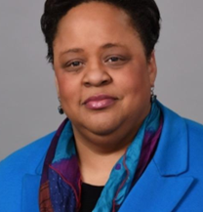
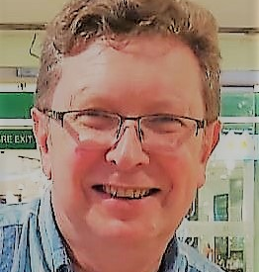
Mastering Mentoring
Audrey Murrell
Michael Snowden
Audrey Murrell is a professor of business administration at the University of Pittsburgh. She serves on the executive board of the International Mentoring Association and her specialism is mentoring under-represented groups.
Michael Snowden is a renowned researcher in mentoring and pedagogy at the University of Huddersfield. He is widely published in the field of mentoring and co-authored the 2018 book ‘Mentorship, Leadership, and Research.’

Slide 8
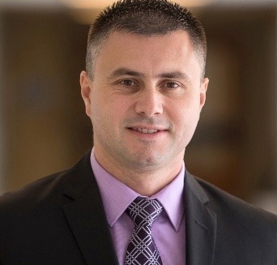
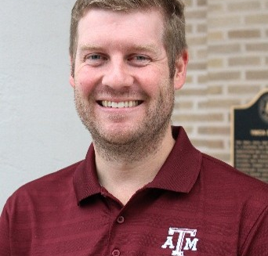
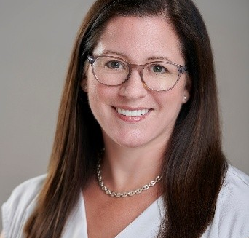
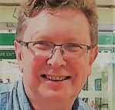
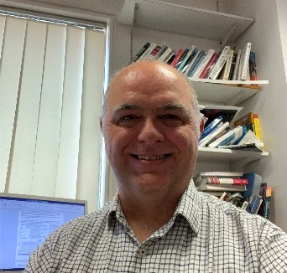
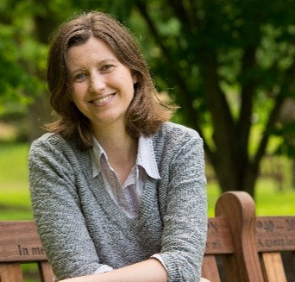
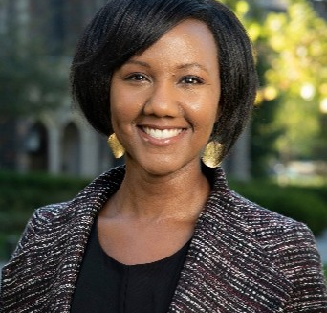
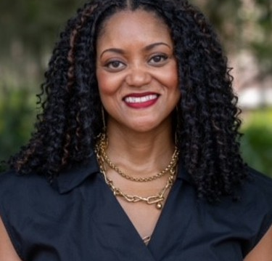
Mastering Mentoring
Ben Kutsyuruba
Clint Patterson
Colleen Mouw
Mike Snowden
Queens University
Texas A&M University
University of Rhode Island
University of Huddersfield
Paul Stokes
Sam Hopkins
Sherilynn Black
Tamara Bertrand Jones
Sheffield Hallam University
University of Surrey
Duke University
University of Illinois Urbana-Champaign

Slide 9

Mastering Mentoring
Elizabeth Sturdy, Director of Mentoring and Academic Success Initiatives at University of California, Davis
Levon T. Esters, Vice Provost for Graduate Education and Dean of J. Jeffrey and Ann Marie Fox Graduate School, The Pennsylvania State University
Jenni Jones, Professor in Coaching and Mentoring, University of Wolverhampton Business School
Kate Thornton, Associate Professor in the Faculty of Education, Te Herenga Waka, Victoria University of Wellington
Laura Lunsford, Evaluator, US National Science Foundation and Professor of Psychology, Campbell University
Roger B. Fillingham, Distinguished Professor and Associate Dean of Planning and Institutional Effectiveness, University of Florida (UF) College of Dentistry
Paul Monahan, Learning and Development Manager, Queen’s University Belfast

Slide 10
Mastering Mentoring
By the end of the program learners will:
  Have a good understanding of what constitutes an effective and productive mentoring relationship and how to cultivate one.
  Have improved communication skills including giving feedback, active listening and communicating across cultural differences.
  Be confident that they can conduct mentoring relationships safely and ethically and will have an awareness of safeguarding.
  Have increased efficacy in reflective practice, goal setting and development planning.

Slide 11
Mastering Mentoring
For Mentors
Introduction to mentoring | What is mentoring Phases of mentoring Reciprocity in mentoring Qualities and skills of effective mentors
Roles and responsibilities | Roles and support Structured vs. unstructured mentoring How a mentor can support career development Contextual awareness in mentoring
Developing a mentoring plan | Aligning goals Identifying opportunities and resources Mentoring agreements Resolving disagreements
Establishing relationships, building rapport and developing trust | How to develop positive relationships Building rapport Emotional intelligence Strategies for growing trust Constructive feedback
Mentoring across difference | What is mentoring across difference Awareness of self Creating safety in relationships Communicating meaningfully
Navigating challenges in mentoring | Deepening understanding Increasing collaboration Navigating the unexpected Helping mentees to adapt to change
For Mentees
Introduction to mentoring | What is mentoring What makes mentoring effective Mentoring models Types of mentoring
Roles and responsibilities | How to find a mentor Establishing shared expectations Mentoring up How a mentor can support career development
Developing a mentoring plan | Identifying goals Identifying opportunities and resources Aligning Expectations Mentoring agreements Resolving disagreements
Establishing relationships, building rapport and developing trust | How to develop positive relationships Building rapport Emotional intelligence Strategies for growing trust
Building your mentoring network | Where to find a mentor How to approach mentors Moving on from a mentoring relationship
Becoming a mentor | Key mentor skills Things to avoid Mentoring roles Continuing developing for mentoring

Slide 12
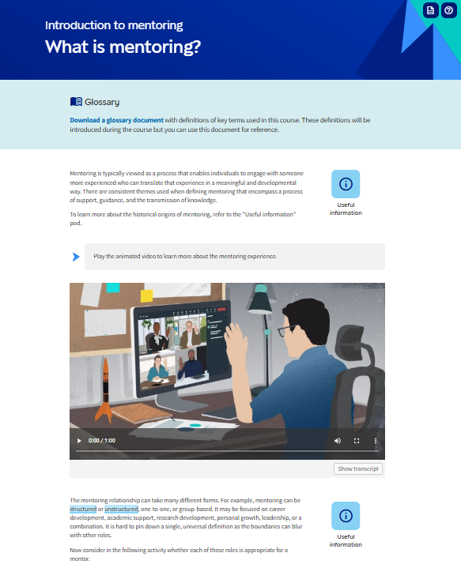
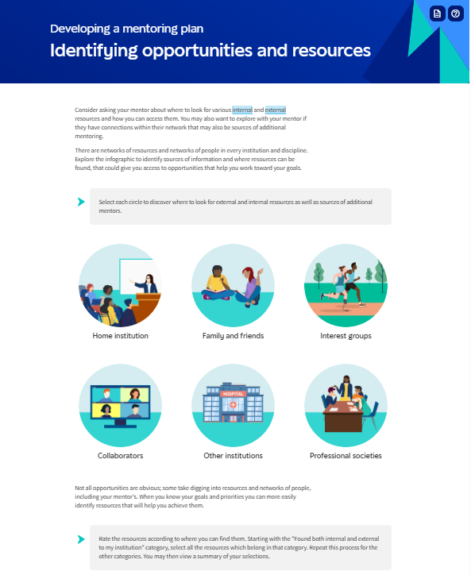
Mastering Mentoring
Screens

Slide 13
Mastering Mentoring
Mastering Mentoring is hosted on Epigeum’s dedicated online platform and is accompanied by an Instructor Manual, as well as other resources to support you in implementing and promoting the program at your institution.

Slide 14
https://learningresources.sagepub.com/epigeum/research/mentoring

